Slide 1
Algorithm Efficiency
Chapter 10
© 2017 Pearson Education, Hoboken, NJ. All rights reserved

Slide 2
What Is a Good Solution?
A program incurs a real and tangible cost.
  Computing time
  Memory required
  Difficulties encountered by users
  Consequences of incorrect actions by program
A solution is good if …
  The total cost incurs …
  Over all phases of its life … is minimal
© 2017 Pearson Education, Hoboken, NJ. All rights reserved

Slide 3
What Is a Good Solution?
Important elements of the solution
  Good structure
  Good documentation
  Efficiency
Be concerned with efficiency when
  Developing underlying algorithm
  Choice of objects and design of interaction between those objects
© 2017 Pearson Education, Hoboken, NJ. All rights reserved

Slide 4
Measuring Efficiency of Algorithms
Important because
  Choice of algorithm has significant impact
Examples
  Responsive word processors
  Grocery checkout systems
  Automatic teller machines
  Video machines
  Life support systems
© 2017 Pearson Education, Hoboken, NJ. All rights reserved

Slide 5
Measuring Efficiency of Algorithms
Analysis of algorithms
  The area of computer science that provides tools for contrasting efficiency of different algorithms
  Comparison of algorithms should focus on significant differences in efficiency
  We consider comparisons of algorithms, not programs
© 2017 Pearson Education, Hoboken, NJ. All rights reserved

Slide 6
Measuring Efficiency of Algorithms
Difficulties with comparing programs (instead of algorithms)
  How are the algorithms coded
  What computer will be used
  What data should the program use
Algorithm analysis should be independent of
  Specific implementations, computers, and data
© 2017 Pearson Education, Hoboken, NJ. All rights reserved

Slide 7
The Execution Time of Algorithms
An algorithm’s execution time is related to number of operations it requires.
  Algorithm’s execution time is related to number of operations it requires.
Example: Towers of Hanoi
  Solution for n disks required 2^{n} – 1 moves
  If each move requires time m
  Solution requires (2^{n} – 1) × m time units
© 2017 Pearson Education, Hoboken, NJ. All rights reserved

Slide 8

Algorithm Growth Rates
Measure an algorithm’s time requirement as function of problem size
Most important thing to learn
  How quickly algorithm’s time requirement grows as a function of problem size
  Demonstrates contrast in growth rates
© 2017 Pearson Education, Hoboken, NJ. All rights reserved

Slide 9
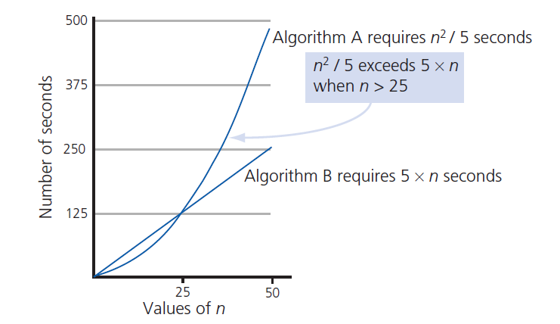
Algorithm Growth Rates
FIGURE 10-1 Time requirements as a function of problem size n
© 2017 Pearson Education, Hoboken, NJ. All rights reserved

Slide 10
Analysis and Big O Notation
Algorithm A is said to be order f (n),
  Denoted as O( f (n))
  Function f(n) called algorithm’s growth rate function
  Notation with capital O denotes order
Algorithm A of order denoted O(f(n))
  Constants k and n₀ exist such that
  A requires no more than k × f(n) time units
  For problem of size n ≥ n₀
© 2017 Pearson Education, Hoboken, NJ. All rights reserved

Slide 11
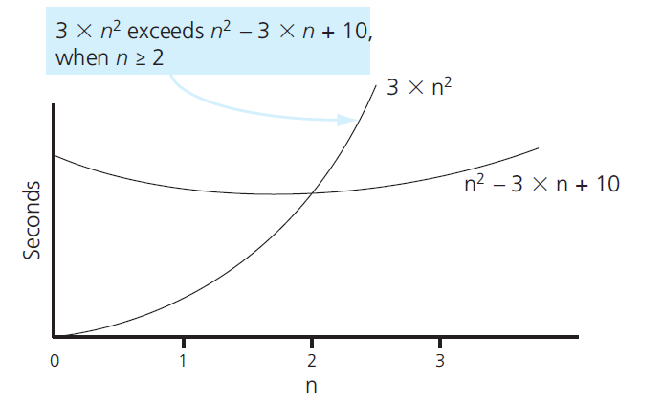
Analysis and Big O Notation
FIGURE 10-2 The graphs of 3 × n² and n² - 3 × n + 10
© 2017 Pearson Education, Hoboken, NJ. All rights reserved

Slide 12

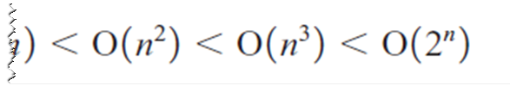
Analysis and Big O Notation
Order of growth of some common functions
© 2017 Pearson Education, Hoboken, NJ. All rights reserved

Slide 13
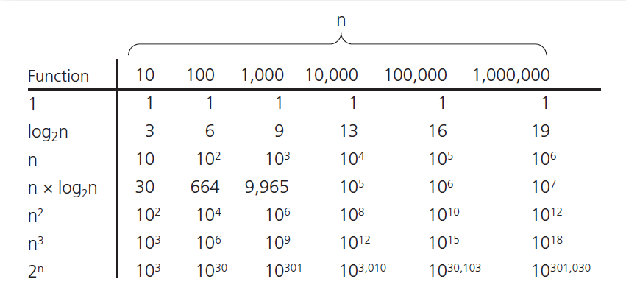
Analysis and Big O Notation
FIGURE 10-3 A comparison of growth-rate functions
© 2017 Pearson Education, Hoboken, NJ. All rights reserved

Slide 14
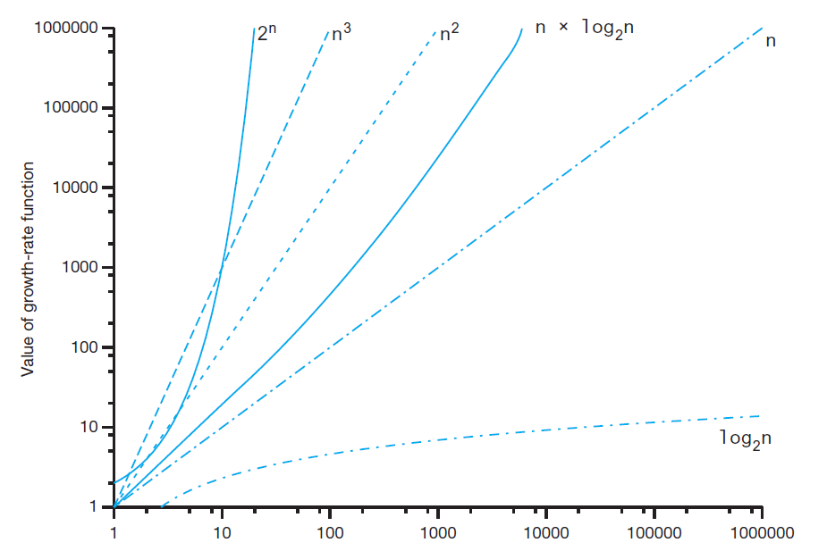
Analysis and Big O Notation
FIGURE 10-4 A comparison of growth-rate functions
© 2017 Pearson Education, Hoboken, NJ. All rights reserved

Slide 15
Analysis and Big O Notation
Worst-case analysis
  Worst case analysis usually considered
  Easier to calculate, thus more common
Average-case analysis
  More difficult to perform
  Must determine relative probabilities of encountering problems of given size
© 2017 Pearson Education, Hoboken, NJ. All rights reserved

Slide 16
Keeping Your Perspective
ADT used makes a difference
  Array-based getEntry is O(1)
  Link-based getEntry is O(n)
Choosing implementation of ADT
  Consider how frequently certain operations will occur
  Seldom used but critical operations must also be efficient
© 2017 Pearson Education, Hoboken, NJ. All rights reserved

Slide 17
Keeping Your Perspective
If problem size is always small
  Possible to ignore algorithm’s efficiency
Weigh trade-offs between
  Algorithm’s time and memory requirements
Compare algorithms for style and efficiency
© 2017 Pearson Education, Hoboken, NJ. All rights reserved

Slide 18
Efficiency of Searching Algorithms
Sequential search
  Worst case: O(n)
  Average case: O(n)
  Best case: O(1)
Binary search
  O(log₂n) in worst case
  At same time, maintaining array in sorted order requires overhead cost … can be substantial
© 2017 Pearson Education, Hoboken, NJ. All rights reserved

Slide 19
End
Chapter 10
© 2017 Pearson Education, Hoboken, NJ. All rights reserved

